Slide 1




THE GLOBAL ACCREDITATION SYSTEM
The ILAC and IAF Handbook
Updated in June 2025
Notes:
https://www.freepik.com/free-photo/global-connections_4103204.htm#query=global&position=8&from_view=search

Slide 2
GLOBAL VISION
03
APPLICATION OF THE GLOBAL ACCREDITATION SYSTEM
29
IAF & ILAC
04
Common Aims
Quality Infrastructure
The Arrangements
Objectives
DOCUMENTS AND PUBLICATIONS
30
MEMBERSHIP TYPES
31
ABOUT IAF
08
IAF Structure
IAF Committees
Coverage of the IAF MLA
Status of the IAF MLA
ILAC PARTNERS
32
IAF PARTNERS
34
ABOUT ILAC
16
HOW DO THE COMMITTEES WORK?
36
ILAC Structure
ILAC Committees
Coverage of the ILAC MRA
Status of the ILAC MRA
OBLIGATIONS AS AN AB?
37
IAF/ILAC TIMELINE
24
WORLD ACCREDITATION DAY
39
IAF & ILAC MULTILATERAL MRAS
25
SOURCES OF FURTHER INFORMATION
Benefits
40
THE ROUTE TO SIGNING THE ARRANGEMENTS
28
CONTACT DETAILS
41

Slide 3




GLOBAL VISION
VISION
VISION
Accredited once accepted everywhere.
Accreditation makes the world better.
MISSION
MISSION
To be the global solution for the national, regional and international demonstration of equivalence of reliable results from testing, calibration, inspection and related activities in both voluntary and mandatory fields/sectors.
IAF facilitates trade and supports sustainable development using internationally recognized accredited conformity assessment to deliver the confidence needed for market acceptance of goods and services.

Slide 4



COMMON AIMS OF IAF AND ILAC
Support conformity assessment schemes which reduces risk for businesses, regulators and the consumer by ensuring that accredited services can be relied upon
Government and regulators relying on the Arrangements to further develop or enhance trade agreements
To support world trade by eliminating technical barriers, realising the free-trade goal of ‘accredited once and accepted everywhere’

Slide 5

QUALITY INFRASTRUCTURE
Quality Infrastructure is the system comprising the organisations, the policies, relevant legal and regulatory framework, and practices needed to support and enhance the quality, safety and environmental soundness of goods, services and processes.
Utilising standards, metrology, accreditation and conformity assessment, this framework, supported by multilateral mutual recognition arrangements, has a positive impact on trade in the developed world and unlocks the trading potential of developing economies.
Notes:
https://www.freepik.com/free-photo/professional-industrial-cleaner-protection-work-wear-smiling-holding-fist-high-production-plant_11450737.htm#page=6&position=6&from_view=author

Slide 6


The IAF and ILAC Arrangements
Accreditation body members deemed competent through a peer evaluation process
  ISO/IEC 17011
  IAF-ILAC ‘A Series’ documents
Signatories must recognise certificates, reports and results issued, as well as reference materials produced and proficiency testing programs provided by organisations accredited by other signatories
Provides businesses with assurance that overseas bodies operate to the same standard
Removes technical barriers to trade by eliminating redundant conformity assessment
Notes:
https://www.freepik.com/free-photo/illustration-several-yellow-lights-arranged-form-pentagon_10835633.htm

Slide 7




IAF AND ILAC OBJECTIVES
IAF and ILAC are global networks of accreditation bodies and organisations involved in conformity assessment activities. Objectives include:
Provide assistance to developing countries by providing appropriate support to new accreditation activities
Maintain the Arrangements, and expand coverage into new economies
OBJECTIVES
Act as a central ‘hub’ to harmonise conformity assessment best practice
Increase cooperation with all relevant stakeholders

Slide 8

ABOUT IAF
IAF is a global association of accreditation bodies and other bodies interested in conformity assessment in the fields of management systems, products, processes, services, persons, validation and verification and other similar programmes of conformity assessment.
Its main purpose is to operate and maintain a global Multilateral Recognition Arrangement (the IAF MLA) that enables the mutual recognition of certificates and validation/verification statements issued by conformity assessment bodies accredited by signatories to the IAF MLA, in order to provide recognised conformity assessment activities and global acceptance of conformity assessment certificates and statements.
IAF also provides training, develops documentation (where required) to promote common accreditation practices, and a forum for sharing best practice.
Notes:
https://www.freepik.com/free-photo/close-up-picture-hand-watering-sapling-plant_10992177.htm#query=economic%20development%20plants&position=0&from_view=search

Slide 9
IAF STRUCTURE
IAF Members
Financial Oversight Committee (FOC)
Treasurer
Board of Directors (BOD)
Secretary
Quality Manager
Executive Committee (EC) includes Directors
Database Management Committee (DMC) of IAF Database, LLC
Communications & Marketing Committee (CMC)
Development Support Committee (DSC)
MLA Committee (MLAC)
Technical Committee (TC)
Conformity Assessment Body Advisory Committee (CABAC)
Accreditation Body Information Exchange Group (ABIEG)
User Advisory Committee (UAC)

Slide 10

IAF STRUCTURE
01
02
03
IAF Members
Board of Directors (BOD)
Executive Committee (EC) (includes Directors)
The highest level of authority in IAF is the Members, who make decisions and lay down policies in Annual Meetings or via ballots (Section 3.02 of the IAF Bylaws).
The Board is responsible for legal actions, for developing broad policy directions for IAF, and for ensuring that the day-to-day work of IAF is carried out in accordance with policies approved by Members.
The Executive Committee is responsible to the Board for the day-to-day work of IAF on the basis of decisions made by the Members and directions by the Board.
Notes:
https://www.freepik.com/free-photo/workman-store-house-orange-helmet_16934276.htm?query=engineering%20industrial%20training&collectionId=1525&&position=29&from_view=collections

Slide 11

IAF MAIN COMMITTEES
MLA Committee (MLAC)
01
Responsible for the implementation and maintenance of the IAF arrangement
Development Support Committee (DSC)
02
Responsible for representing the interests of developing countries and operates in conjunction with the International Laboratory Accreditation Cooperation (ILAC)
03
Technical Committee (TC)
Coordinates the work of its Working Groups and Task Forces and addresses technical matters
Communications & Marketing Committee (CMC)
04
Handles the discussion, development and coordination of any matter related to communications and marketing activities at the global and regional levels
Strives to raise the awareness, lift the profile and improve the image of accreditation at the global, regional and national levels
Notes:
https://nl.freepik.com/vrije-photo/digitaal-scherm-met-omgevingsdag_12976397.htm#query=eco%20wereldbol&position=16&from_view=keyword

Slide 12
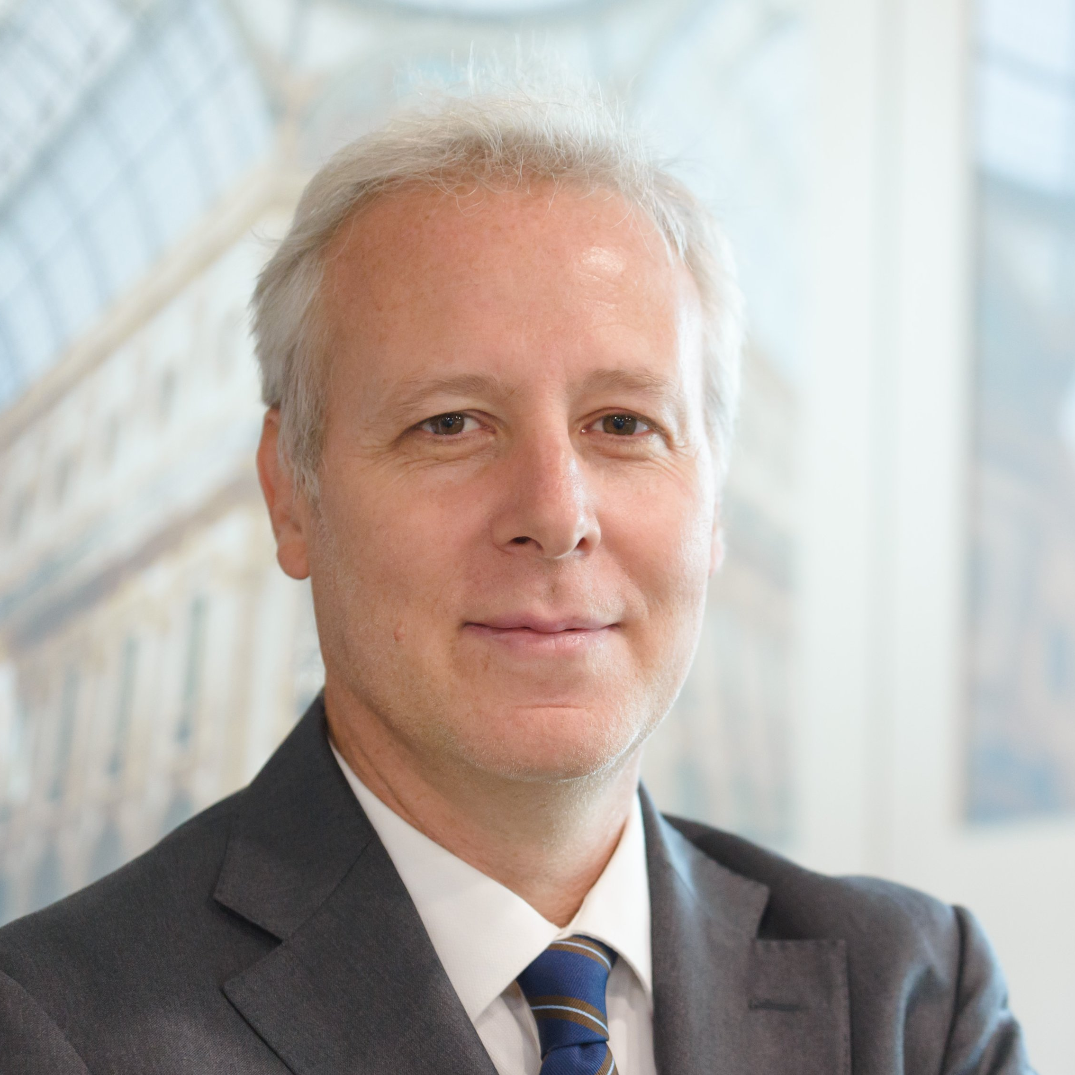

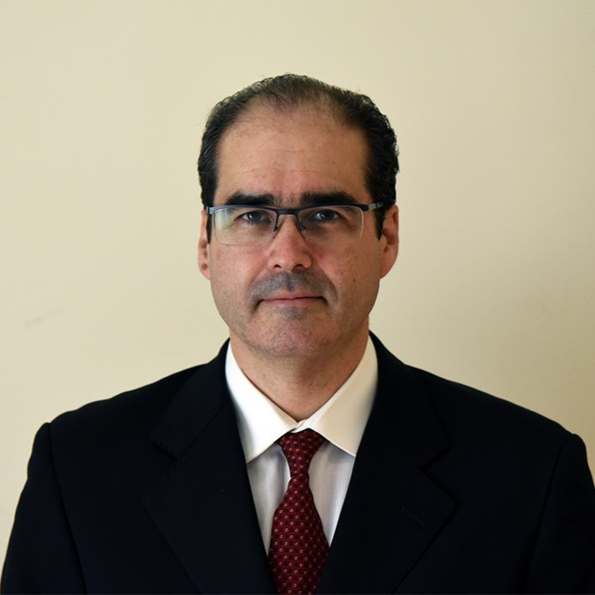

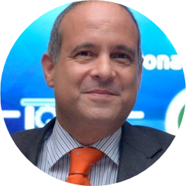

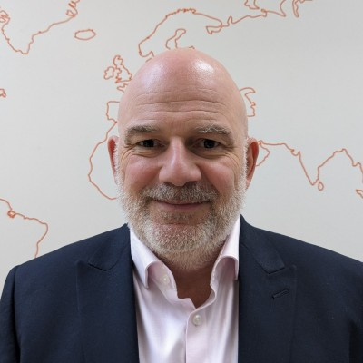




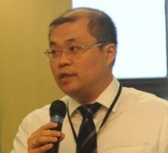
EC members
Mr. Emanuele Riva
Ms. Lori Gillespie
Mr. Victor Gandy
Mr. Warren Merkel
Mr. Pedro Alves
Mr. Kevin Belson
IAF Chair
IAF Vice-Chair
IAF Secretary
IAF Treasurer
CABAC Chair
TC Chair
Mr. Marcus Long
Mr. Wolfram Hartmann
Mr. Aldin Hilbrands
Mr. Brahim Houla
Mr. Rajesh Maheshwari
Mr. Fei Yang
CMC Chair
ABIEG Co-Chair
UAC Chair
MLAC Chair
ABIEG Co-Chair
DSC Chair

Slide 13



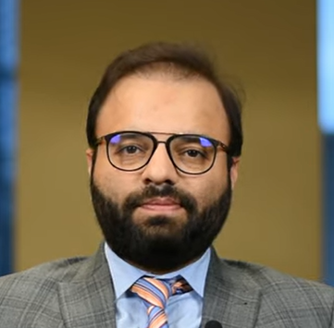

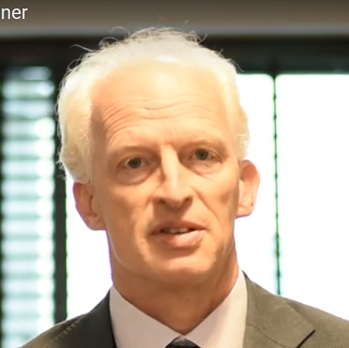
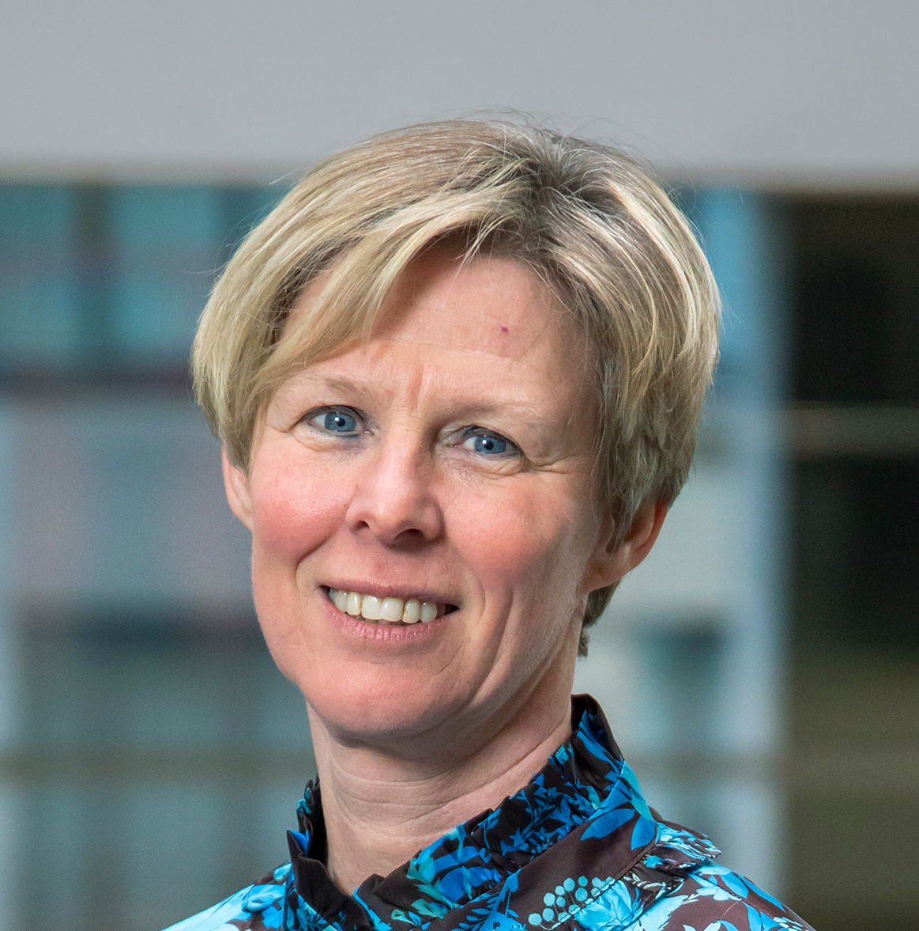





EC members
Mr. Adel Alkeaid
Mr. Robin Gopee
Mr. Norman Brunner
Ms. Etty Feller
Mr. Hamza Khan
ARAC Representative
SADCA Representative
IAF JWG A-Series Co-Convenor (Guest)
ILAC Chair (Guest)
Quality Manager (Guest)
Mr. Celestine Okanya
Ms. Maureen Logghe
Ms. Andrea Melo
Mr. Raj Nathan
Mr. Rick Parsons
AFRAC Representative
EA Representative
IAAC Representative
APAC Representative
Chief Financial Officer (Guest)

Slide 14
COVERAGE OF THE IAF MLA (June 2025)
IAF MLA Signatories

Slide 15





{
STATUS OF THE IAF MLA (June 2025)
There are 87 IAF MLA AB Signatories representing a total of 100 economies in the following main scope areas.
The IAF MLA has 32 sub-scopes, which can be viewed in the IAF MLA Status document.
Main Scope:
Management Systems
ISO/IEC 17021-1
Product
ISO/IEC 17065
Persons
ISO/IEC 17024
Validation and Verification
ISO/IEC 17029
Notes:
https://www.pexels.com/photo/agriculture-alternative-energy-clouds-countryside-414837/

Slide 16



ABOUT ILAC
ILAC is the international authority on laboratory, inspection, reference material producer and proficiency testing provider accreditation with a membership consisting of accreditation bodies and affiliated organisations throughout the world.
ILAC promotes the increased global use and acceptance by industry and government, of the results from accredited laboratories and inspection bodies, proficiency testing programs from accredited proficiency testing providers and reference materials produced by accredited reference material producers.
ILAC operates and manages the multilateral, Mutual Recognition Arrangement (the ILAC MRA) to promote the acceptance of accredited test, calibration and inspection data and results, proficiency testing providers and reference material producers.

Slide 17
ILAC STRUCTURE
The General Assembly (GA) is the primary body of ILAC and ensures that specific tasks are pursued in accordance with the objectives of ILAC. All members of ILAC are eligible to nominate one representative.
General Assembly
Arrangement Council
Advisory Committees
Stakeholder Forum
Executive Committee
Secretariat
Arrangement Management Committee (AMC)
Financial Audit Committee (FAC)
Arrangement Committee (ARC)
Accreditation Committee (AIC)
Marketing and Communications Committee (MCC)
Joint Development Support Committee (JDSC)
Inspection Committee (IC)
ILAC organization chart as at March 2015

Slide 18





ILAC COMMITTEES
Arrangement Council
Arrangement Management Committee (AMC)
Arrangement Committee (ARC)
Accreditation Committee (AIC)
Arrangement Council - is the decision making body for determining signatory and recognition status under the ILAC MRA. The members are delegates nominated by the Full and Associate members.
The Arrangement Management Committee (AMC) - is responsible for the day-to-day management activities of the ILAC MRA on behalf of the Arrangement Council and provides advice on its further development and operation.
Responsible for harmonized implementation and continual improvement of the ILAC Arrangement
Responsible for harmonisation and improvement of accreditation practice at the international level.
Notes:
https://www.freepik.com/free-photo/business-people-meeting_2770453.htm#query=black%20business&position=1&from_view=keyword

Slide 19
ILAC COMMITTEES
Inspection Committee (IC)
Marketing and Communications Committee (MCC)
Stakeholder Forum
(SF)
Joint Development Support Committee (JDSC)
Responsible for the harmonisation and improvement of accreditation practices for inspection activities at the international level.
Responsible for internal and external marketing and communication issues. It is involved with the promotion of ILAC's objectives, and the publication of ILAC documents, newsletters and other information. This committee operates in conjunction with the IAF Communications and Marketing Committee.
Provides a means of interaction and exchange of ideas between ILAC and the stakeholder organisations that the forum members represent.
Responsible for representing the interests of developing countries and operates in conjunction with the International Accreditation Forum (IAF).
Notes:
https://www.freepik.com/free-photo/business-people-meeting_2770453.htm#query=black%20business&position=1&from_view=keyword

Slide 20


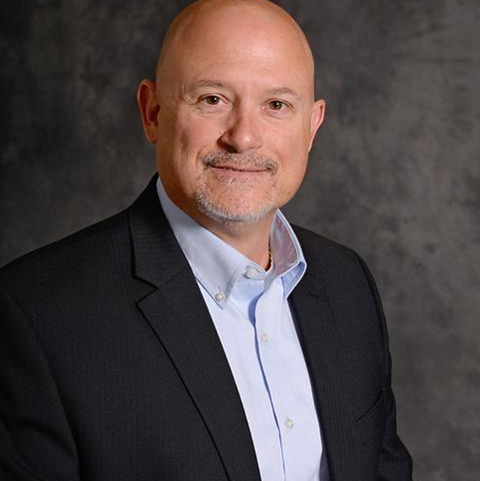


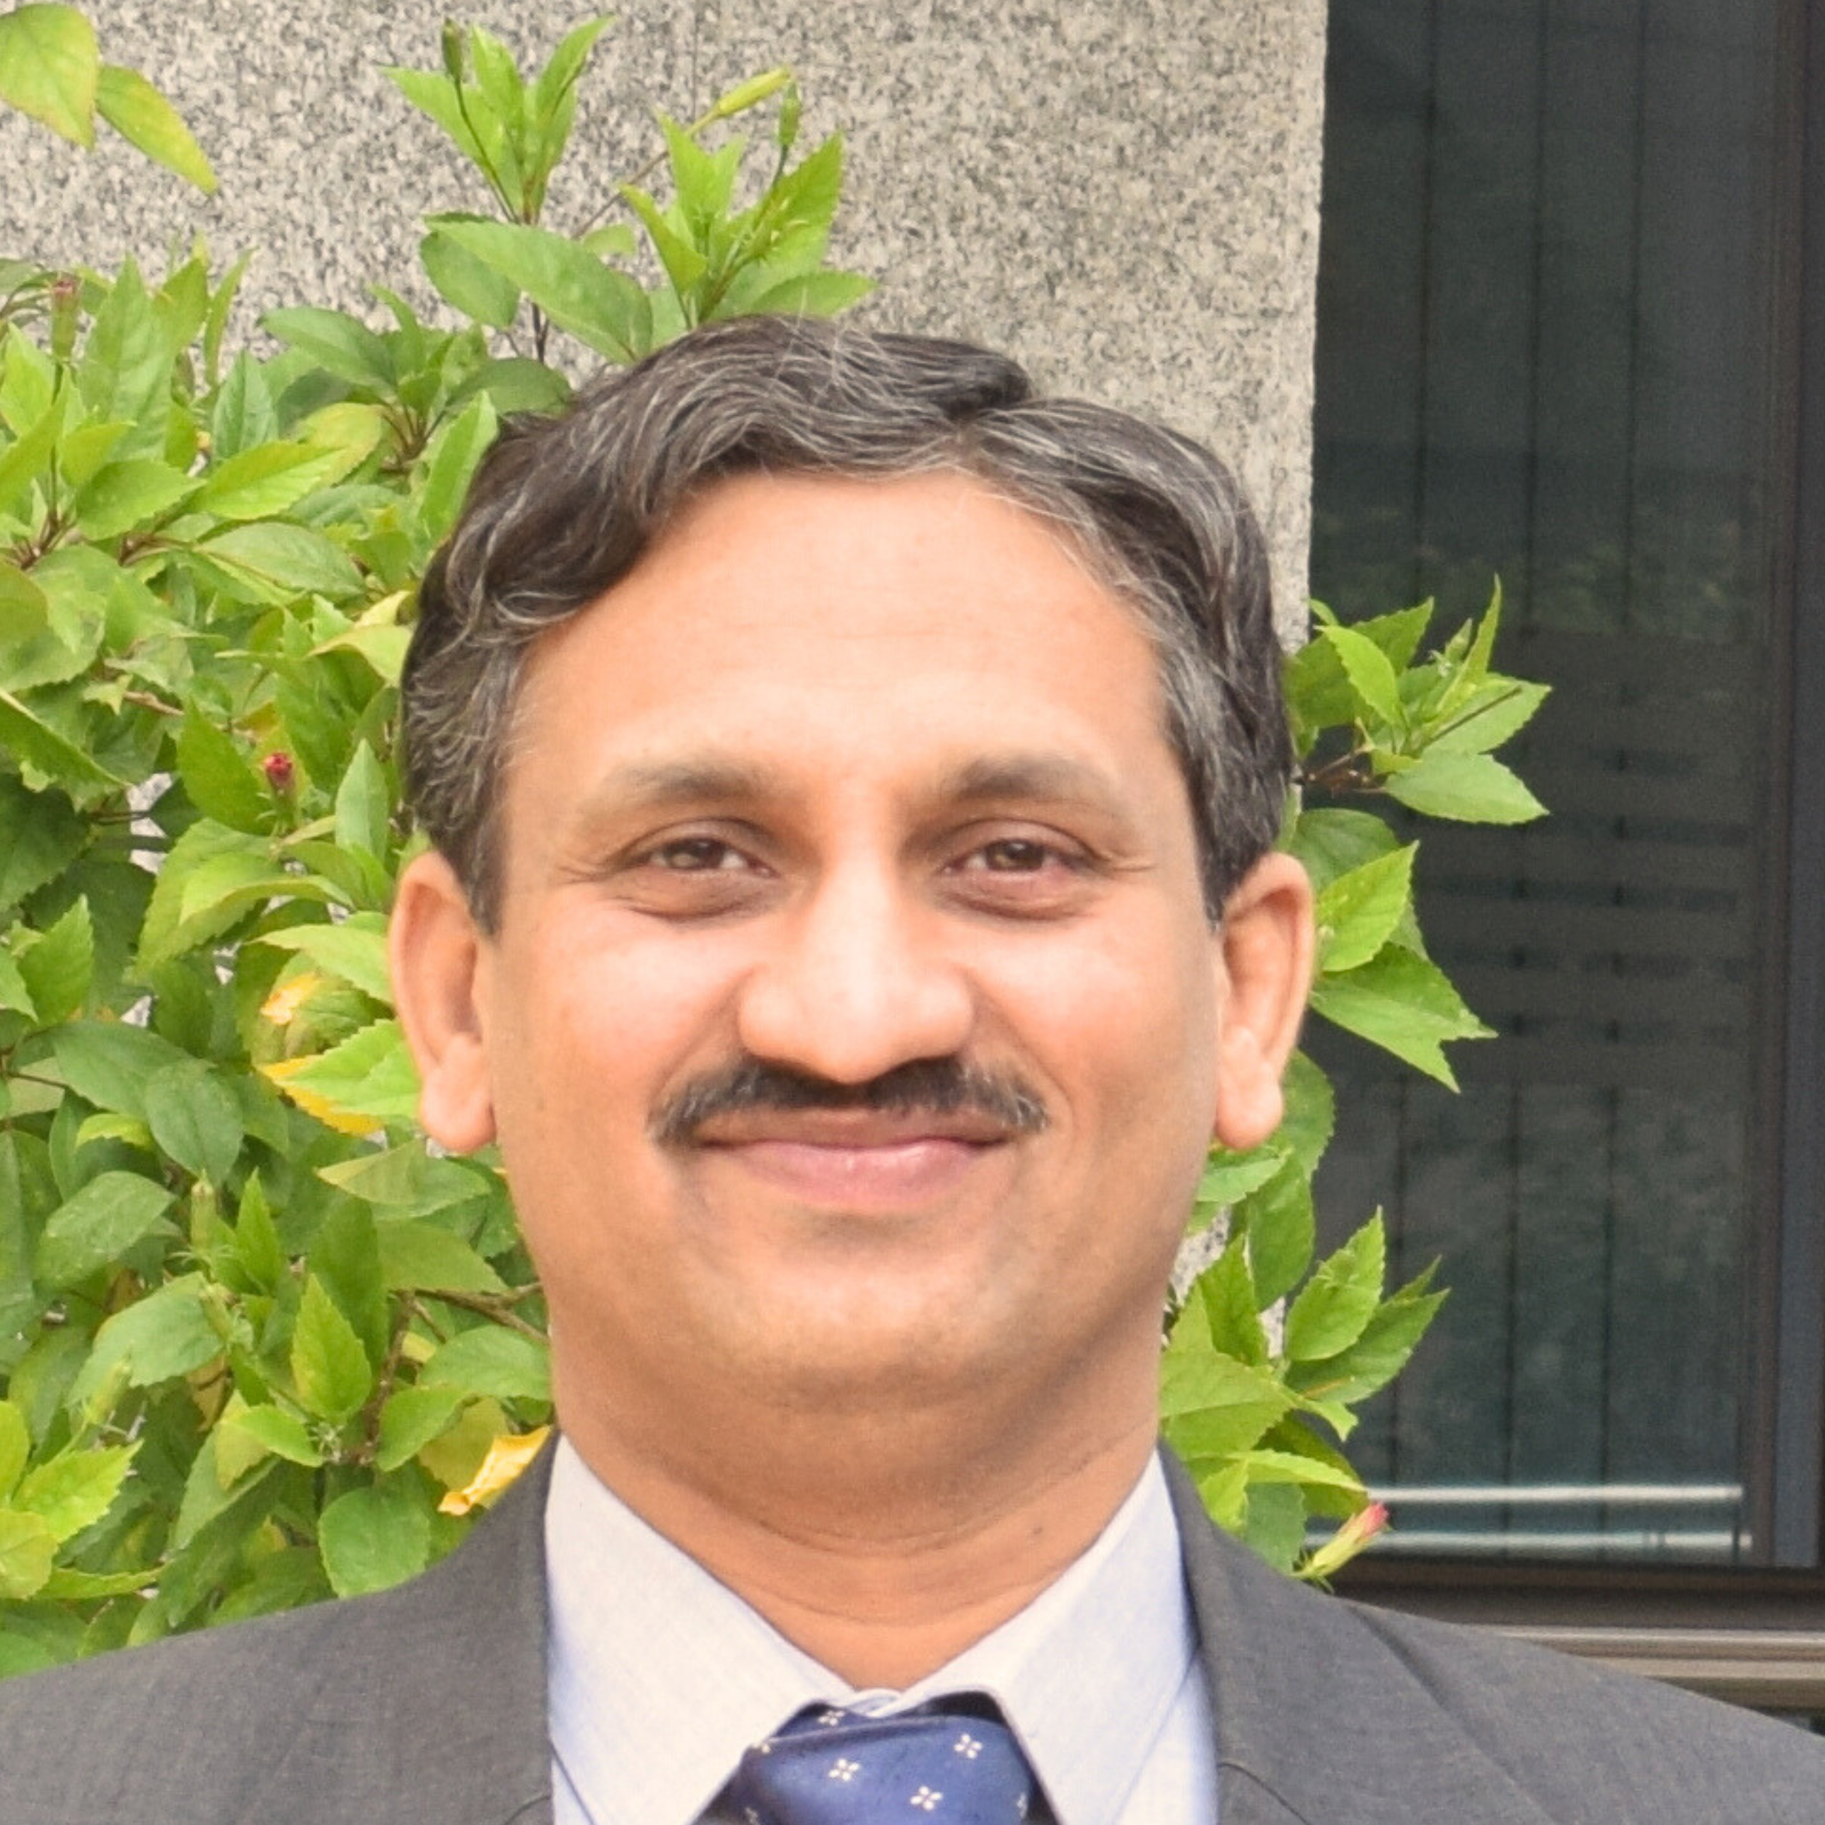

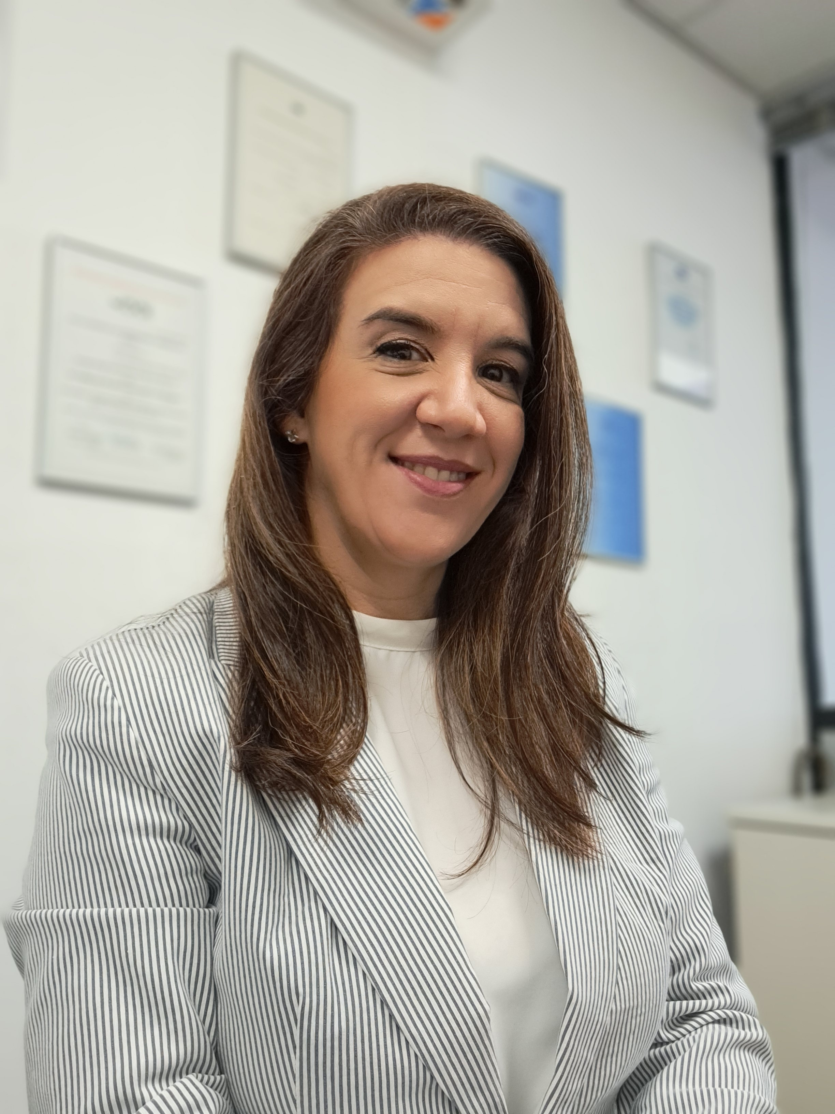

EC members
Ms Etty Feller
Ms Maribel Lopez
Mr Michael Fraser
Mr Trace McInturff
Mr Jeff Gust
Chair
Vice Chair
ILAC Secretary
AMC Chair
Stakeholder Forum Chair
Dr Andreas Hönnerscheid
Mr Natarajan Venkateswaran
Ms Verónica Ramirez
Ms María Paola Mársico
Ms Lorraine Turner
Acting ARC Chair
AIC Chair
MCC Chair
JDSC Chair
Inspection Committee Chair

Slide 21

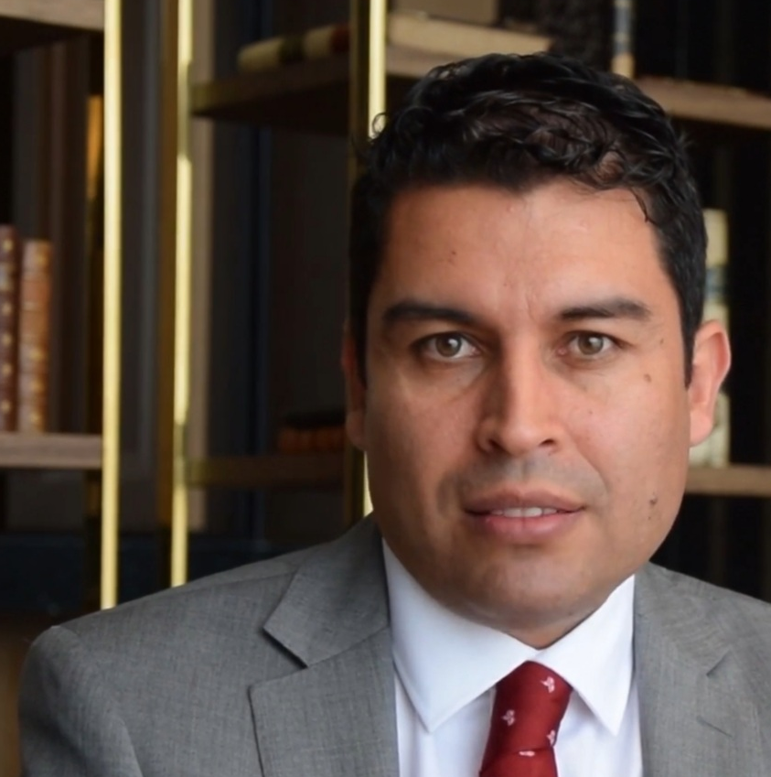




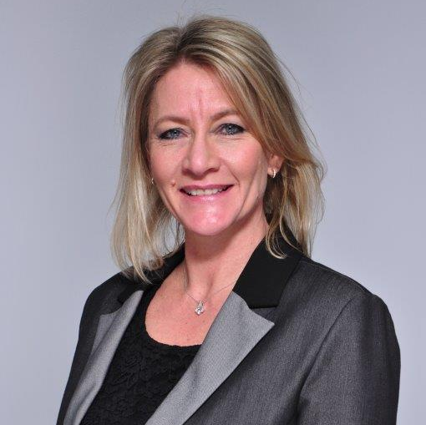
EC members
Ms Amina Ahmed Mohammed
Mr Ferney Chaparro
Mr Ron Josias
Ms Jennifer Evans
ARAC Representative
IAAC Representative
SADCA Representative/ILAC Treasurer
APAC Representative
Mr Emanuele Riva
Dr Andreas Steinhorst
Ms Yolanda Vinnicombe
IAF Chair (Observer)
EA Representative
Acting AFRAC Representative

Slide 22
Coverage of the ILAC MRA (June 2025)
ILAC MRA Signatories
ILAC Associate Members

Slide 23
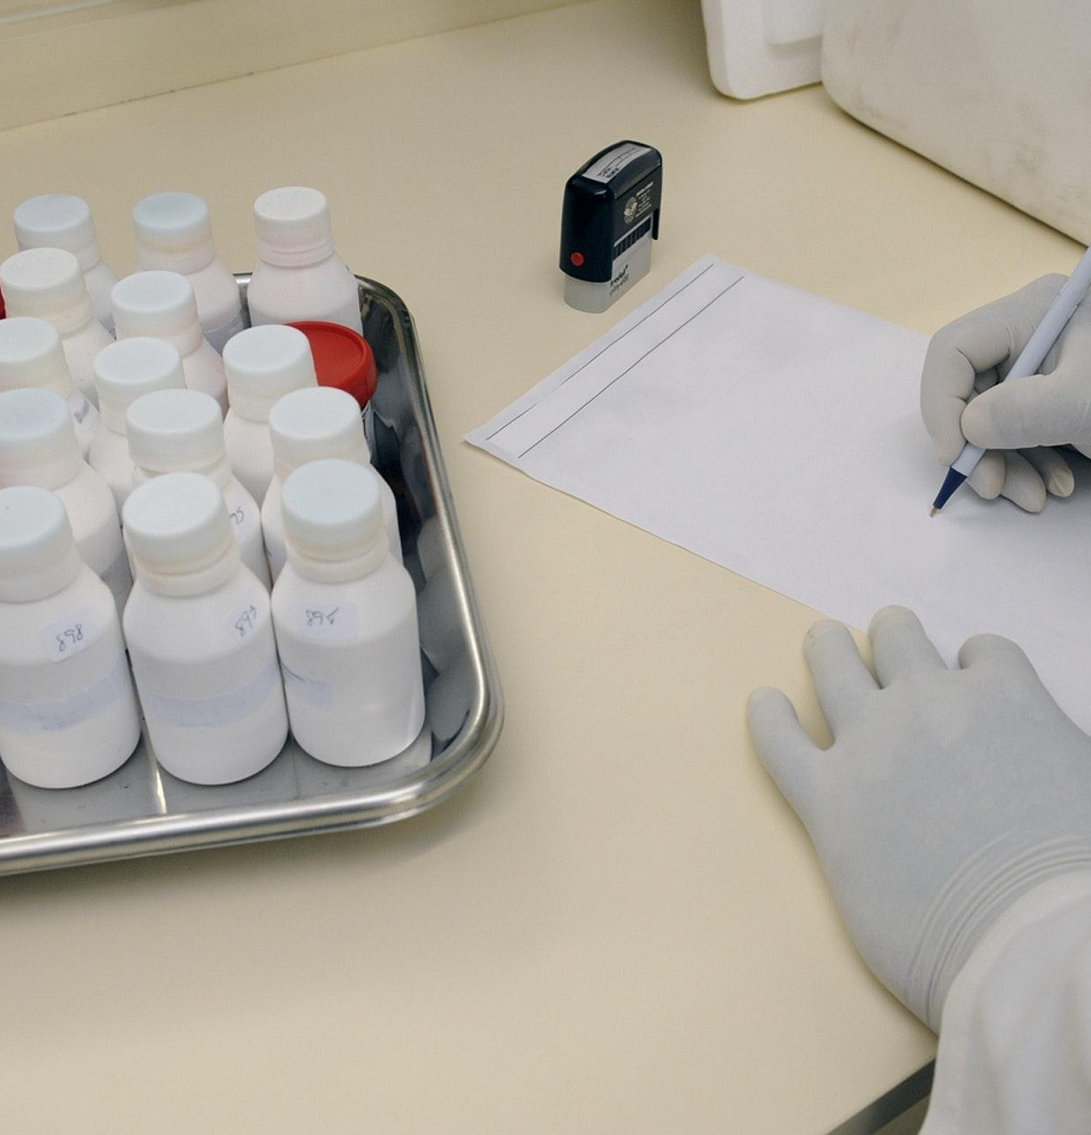
STATUS OF THE ILAC MRA (June 2025)
The ILAC network of members includes 162 bodies from 135 different economies (118 Full Members/MRA Signatories, 17 Associates, 21 stakeholders, 6 Regional Cooperation Bodies)
118 ILAC MRA Signatories representing 119 economies
ILAC MRA covers testing, calibration, inspection, proficiency testing providers and reference material producers
Signatories represent about 95% of Global GDP
Over 97,000 accredited laboratories
Over 14,000 accredited inspection bodies
Over 800 accredited proficiency testing providers
Over 300 reference materials producers
Notes:
https://www.pexels.com/photo/person-in-white-hand-gloves-writing-on-white-paper-207601/

Slide 24
IAF / ILAC TIMELINE
1993 – IAF established
1996 – ILAC
MOU
2000 - ILAC MRA
Testing & Calibration
2003 - ILAC Incorporated
2007 - IAF MLA
Persons
2014 - IAF MLA
Validation &
Verification
2020 - ILAC
MRA Reference
Material Producers
1977 – ILAC established
1995 –
IAF MOU
1998 - IAF MLA Management Systems
IAF Bylaws
IAF Incorporated
2001 1st Joint IAF - ILAC General Assembly
2004 - IAF MLA Product
2012 - ILAC MRA Inspection
2019 - ILAC MRA Proficiency Testing Providers

Slide 25





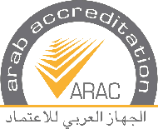
IAF/ILAC MULTILATERAL MRAS
European Cooperation
for Accreditation (EA)
Inter-American Accreditation Cooperation (IAAC)
A laboratory, inspection body, certification body, proficiency testing provider, reference material producer or validation/verification body accredited by one partner has equivalent competence to a laboratory, inspection body, certification body, proficiency testing provider, reference material producer or validation/verification body accredited by the other partner(s).
The structure of the global accreditation system is divided into two levels: the regional level (EA, ARAC, APAC, SADCA, AFRAC and IAAC) and the global level (ILAC and IAF).
The IAF MLA recognises AFRAC, APAC, ARAC, EA, IAAC and SADCA.
The ILAC MRA recognises AFRAC , APAC, ARAC, EA, IAAC and SADCA.
Asia Pacific
Accreditation Cooperation
(APAC)
Southern African
Development Community Cooperation in Accreditation (SADCA)
African Accreditation Cooperation (AFRAC)
Arab Accreditation Cooperation (ARAC)

Slide 26

IAF/ILAC MULTILATERAL MRAS (Continued)
Accreditation bodies in the major parts of the world are both members of a region and of the global associations.
01
ILAC and IAF rely on the evaluations undertaken by the recognised regions to grant and maintain signatory status for the accreditation bodies.
Exceptions are accreditation bodies from parts of the world where a regional cooperation is not established yet; those accreditation bodies are only members of the global associations (unaffiliated bodies).
05
02
Recognition of a region is achieved after successful peer evaluation by ILAC or IAF.
04
03
Stakeholders and other interested parties may also be members of the global associations.

Slide 27




THE BENEFITS OF THE IAF/ILAC MULTILATERAL MLAS/MRAS
For Government
Facilitator of trade
An efficient enforcement and monitoring tool
For Business
Greater acceptance of products and services
Avoid costs associated with repeat conformity assessment
Informed procurement
For Consumers
Public confidence in goods and services
Minimises product failures or recalls
Notes:
https://www.freepik.com/free-photo/hand-placing-wooden-block-represent-growth_11383313.htm#query=hand%20placing%20wooden%20block&position=1&from_view=search

Slide 28

THE ROUTE TO SIGNING THE ARRANGEMENTS
AB decision to apply for membership to IAF/ILAC Arrangements
Eligible to be a member of a recognized regional cooperation body
Yes
No
Apply to recognised regional cooperation body and go through evaluation process with this organization. Once signatory to regional MRA/MLA apply to IAF/LAC Secretariats and complete paperwork to become member of the IAF and/or ILAC Arrangements
Apply to IAF and/or ILAC Secretariats to become member of Arrangements. Evaluation and decision making process carried out by IAF and/or ILAC as per IAF/ILAC A2
Member of IAF/ILAC Arrangements for defined activities

Slide 29


APPLICATION OF THE GLOBAL ACCREDITATION SYSTEM
There are also good examples of the added value of quality infrastructure on business-benefits.org which includes case studies, research papers, and supporting materials that confirm these benefits for the business community.
www.publicsectorassurance.org was launched by ILAC, IAF, ISO, IEC AND IIOA (formerly IIOC) to illustrate the value of accredited conformity assessment.
It enables government officials and regulators to access international case studies in policy areas, showcasing how different tools are able to deliver results
The site contains links to independent research, where conformity assessment is being used in policy areas such as:
Economic development
Healthcare
Environmental protection
Energy
Food safety
Construction
Crime and security
Notes:
https://www.freepik.com/free-photo/global-environmental-sustainability-background-green-technology_17121775.htm

Slide 30
DOCUMENTS AND PUBLICATIONS
Both organisations publish documents that set out the rules, policies and procedures that members must adhere to. Guidance and informative documents are also available to share best practice and ensure a common interpretation of accreditation practices.
Brochures (B Series)
General ILAC brochures or promotional publications
General Information and Promotional Documents
To raise awareness and understanding of IAF
Guidance (G Series)
The interpretation of accreditation criteria for specific
applications for accreditation bodies and accredited
organisations.
Policy Documents (PL Series)
IAF and Member policy requirements
MLA Documents (ML Series)
Policy and procedures to support the operation of the MLA
Rules (R Series) - Rules (Requirements)
Documents including the Articles and Bylaws and other
documents covering the operation of ILAC as an
incorporated entity.
Informative Documents (ID Series)
To support the consistent application of requirements
Mandatory Documents (MD Series)
Mandatory documents to be used by ABs and CABs
Procedural (P Series)
Procedural and policy publications for the operation of the ILAC Arrangement, and which form part of the criteria for ILAC Arrangement evaluations.
Procedures Documents (PR Series)
Procedures to follow in implementing the IAF programs
Joint IAF / ILAC (A Series) –
Joint IAF and ILAC documents used for the evaluation of regions and unaffiliated bodies.

Slide 31
MEMBERSHIP TYPES
Full Members (Signatories)
Accreditation bodies that have been accepted as signatories to the ILAC MRA, and abide by its terms and conditions and by the ILAC evaluation procedures.
Accreditation Body Members
Accreditation bodies that accredit bodies for validation/
verification and certification of management systems,
products, processes, services and personnel, as well as
for other programmes of conformity assessment.
Accreditation body members must declare their intention
to join the IAF MLA.
Associates
Accreditation bodies not yet signatories to the ILAC MRA, that carry out accreditation of conformity assessment that is officially recognised in that economy.
Association Members
Organisations involved in the use or implementation of
certification or validation/verification systems.
Regional Cooperation Bodies
Formally established regional cooperations having objectives similar to and compatible with ILAC, which are committed to the obligations of the ILAC MRA and which consist of at least four economies.
Regional Accreditation Groups
Regional groupings of Accreditation Bodies whose aims
include the maintenance of Regional Multilateral
Recognition Arrangements recognising the equivalence of
their members' accreditations.
Stakeholders
Representative international, regional and national organizations having an interest in the work of ILAC.

Slide 32












ILAC PARTNERS
ILAC liaises and cooperates with many international bodies such as MoU partners to achieve shared objectives.
International Accreditation Forum
World Anti-Doping Agency
International Organization of Legal Metrology
International Electrotechnical Commission
International Federation of Clinical Chemistry and Laboratory Medicine
International Organisation for Standardization
UN Industrial Development Organisation
International
Bureau for Weights & Measures
International Telecommunications Union
International Federation of Horseracing Authorities
World Bank
International Network on Quality Infrastructure

Slide 33






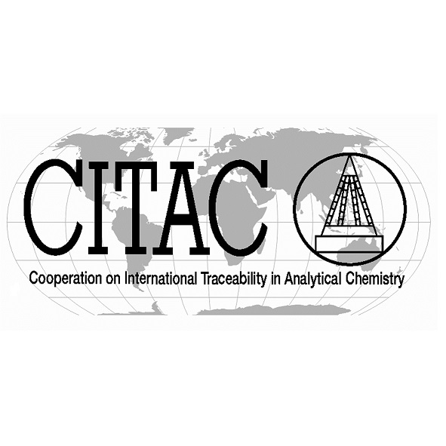

ILAC PARTNERS (Continued)
Joint Committee for Guides in Metrology
Joint Committee for Traceability in Laboratory Medicine
World Trade Organisation
World Health Organisation
Organisation for Economic Cooperation and Development
European Commission
Cooperation on International Traceability in Analytical Chemistry
Asia-Pacific
Economic Cooperation

Slide 34






IAF PARTNERS
IAF works with a number of organisations and cooperates with many international bodies, including numerous MoU partners, to achieve shared objectives.
International Laboratory Accreditation Cooperation
International Organisation
for Standardisation
UN Industrial Development Organisation
International Electrotechnical Commission
International Telecommunications Union
International Organization of Legal Metrology
The Global Food
Safety Initiative
World Bank
International Civil
Aviation Organization
GLOBALG.A.P.

Slide 35





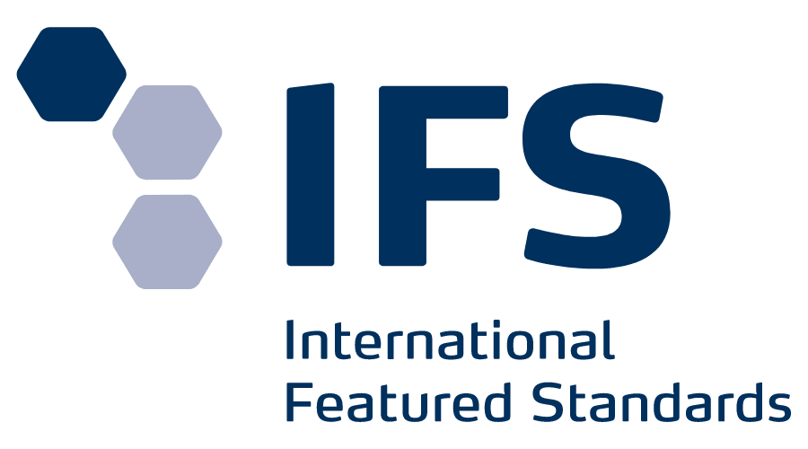


IAF PARTNERS (Continued)
The Quality and Safety
System for Specialty Feed
Ingredients
International Personnel Certification Association
Foundation FSSC
INetQI
BRC Trading Limited
International Featured Standards
International Aerospace Quality Group
European Centre for Certification and Privacy
World Sustainability Organization S.r.l.

Slide 36

HOW DO THE COMMITTEES WORK?
The decisions and agreements reached during meetings are recorded in either Minutes or for the Annual Meetings as Resolutions.
01
Committees, Subcommittees, Working Groups, and Task Forces typically meet once or twice a year, in conjunction with the Mid-Term Meetings of IAF and ILAC and the Annual meetings.
04
Voting may be in person at meetings or by letter-ballot.
02
When discussing issues and documents, the goal is a consensus approach, but, at times, formal voting is required.
03

Slide 37
WHAT ARE MY OBLIGATIONS AS AN AB?
Participating in Annual Meetings and Committees
All members are able and encouraged to join, participate and contribute to the work of ILAC and IAF. This can be done by attending meetings or by email correspondence.
Task Forces are generally set up to complete a particular task and are disbanded on completion.
Working Groups are generally discussion groups in a particular area.
Active participation and contribution to the work of IAF and ILAC in the Mid-Term and Annual Meetings.
Promoting the MRA / MLA
All members are obliged to support the acceptance of the Arrangements.
Notes:
https://iaf.news/

Slide 38

What are my Obligations as an AB? (Continued)
Voting
Voting may be conducted at the meetings, or by email, or electronically.
ILAC and IAF members have an obligation to vote in a timely manner for documents that are circulated for letter-ballot.
You will receive a notification of each ballot and deadlines by email and in most cases will be required to vote online, on the Members side of the websites.
Failure to submit the required number of ballots within a 12-month period may lead to sanctions.
Peer evaluators
ILAC and IAF welcome volunteers to be trained as peer evaluators.
Notes:
https://unsplash.com/photos/OBok3F8buKY

Slide 39

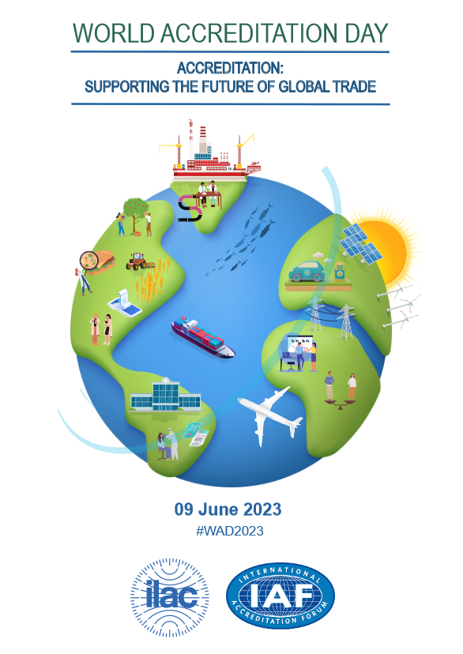
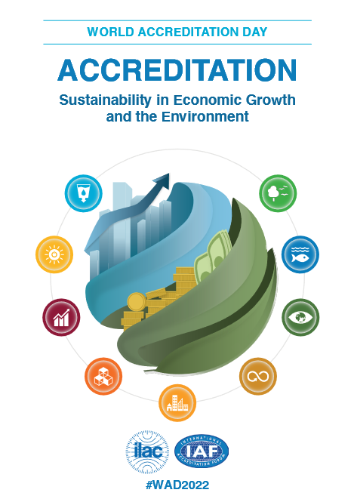

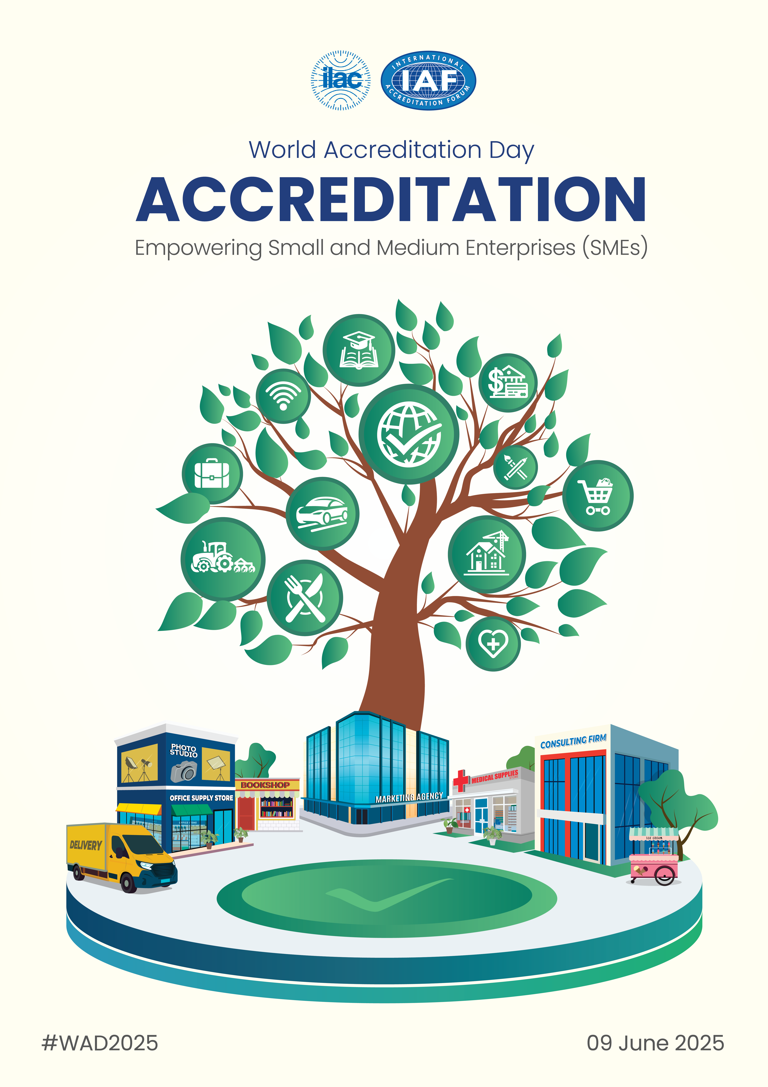

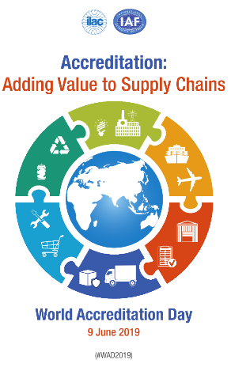
WORLD ACCREDITATION DAY
World Accreditation Day takes place on 9th June each year. A theme is agreed by the Joint Executives, and materials are available from the ILAC and IAF websites to support promotion in your economy. Major conferences, events, workshops, and press campaigns take place in over 90 economies.
World Accreditation Day 2025 (#WAD2025) Accreditation: Empowering Small and Medium Enterprises (SMEs)

Slide 40

SOURCES OF FURTHER INFORMATION
To remain up-to-date with developments, the following sources of information are available:
ILAC News – published twice a year http://ilac.org/news-and-events/ilac-newsletter/
IAF Outlook – published three times a year http://www.iaf.news
ILAC and IAF Intranets – The members only areas of the websites contain valuable information for members, including access to meeting papers, ballots, technical documents, guidance notes, and promotional tools. Contact the Secretariats for access.
Subscribe to the latest IAF updates – https://bit.ly/2SdgR4x
Subscribe to the latest ILAC updates – http://ilac.org/latest_ilac_news/
ILAC and IAF Publications – a wide range of publications are available to download from:
http://ilac.org/publications-and-resources/
https://iaf.nu/en/iaf-documents-categories/
Annual Reports – ILAC and IAF publish an Annual report each year that sets out the key developments and status of the MRA / MLA.
Notes:
https://unsplash.com/photos/Q7wDdmgCBFg

Slide 41














CONTACT DETAILS
The IAF Secretariat
The ILAC Secretariat
+1 (571) 569-1242
+61 8 7092 2655
Secretary@iaf.nu
secretariat@ilac.org
IAF_Global
ILAC_Official
international-accreditation-forum-inc
International Laboratory Accreditation Co-operation (ILAC)
IAFandILAC
IAFandILAC
Notes:
https://www.freepik.com/premium-photo/business-people-stacking-their-hands_4201057.htm

